Slide 1
Climate Change around the World
​ Photo created with The GDELT Project
Alison Garrett
Unsolicited Report to the UN
17 December 2021

Slide 2

COP26 United Nations Climate Change Conference
In 2015 world leaders came together at the COP21 UN Climate Change Conference in Paris France
From this conference came the Paris Agreement, also known as the Paris Accord and Paris Climate Accord
196 parties signed on to set goals to minimize the rise in global temperature as well as emissions reductions
COP26, being held in Glasgow Scotland,
comes as expected results have not been
achieved and commitments are wavering

Slide 3

Understanding World Opinion
The UN is interested in world opinions about this shared challenge
The COP26 Headline Analyzer identifies world opinion and commitment to resolving climate
change issues by analyzing the worldwide COP26 news headlines
​ Photo courtesy COP26

Slide 4
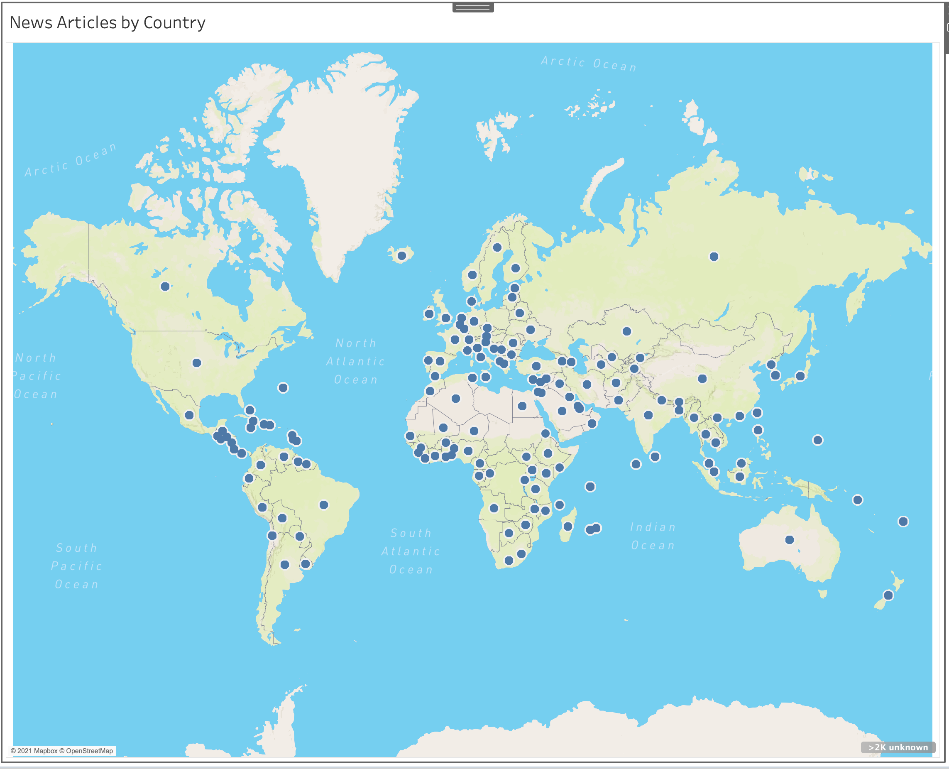
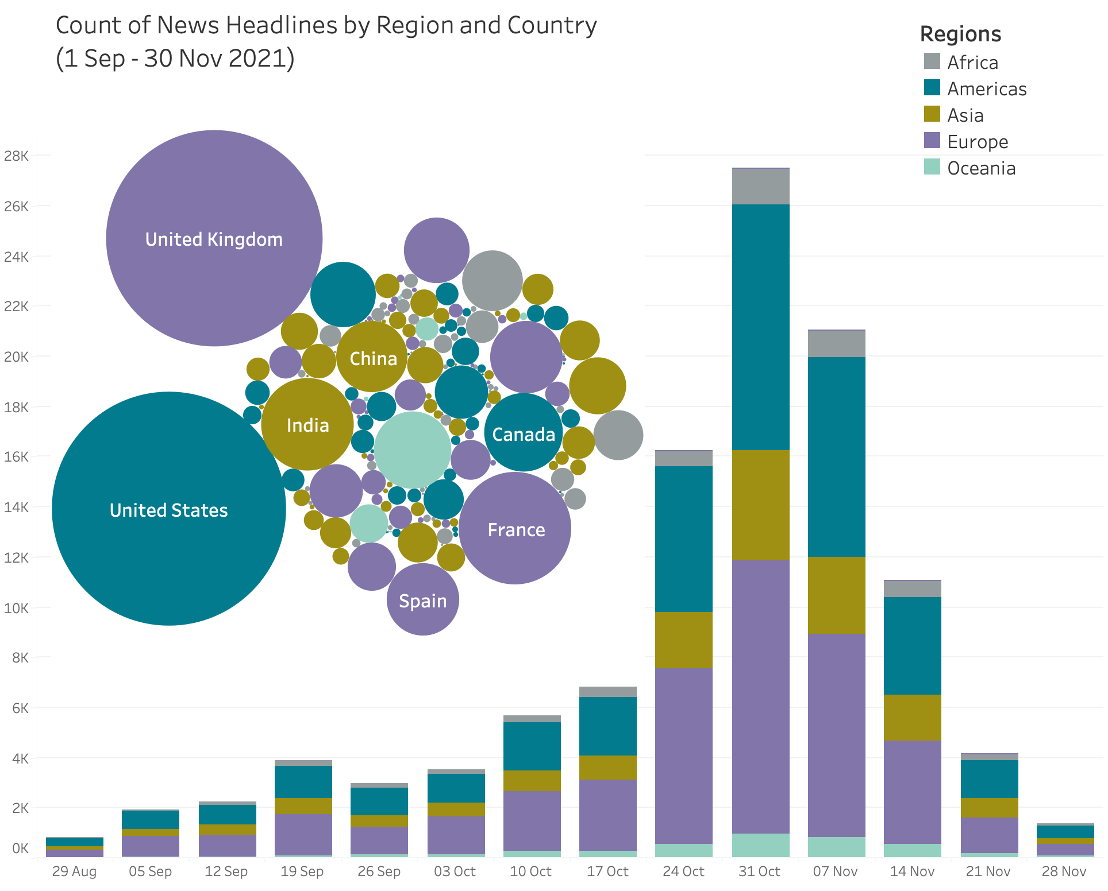
The GDELT Project: Worldwide News Feed
173 Countries
109,390 News Headlines
​ Data from The GDELT Project

Slide 5
Pipeline
Collection and EDA
Modeling
Beautiful Soup
RegEx
Cleaning
TfidfVectorizer
Headline
Source
Country
Language
Interactive
Web App:
Select Region and Date
See Topics, Subjectivity and Polarity
Punctuation
Lowercase
Stopwords
Tokens
No
Stopwords
SQLite db
Streamlitweb app
The GDELT
Project
Select
News
Polarity
Subjectivity
Anchor
Topics
Multi-language
News
Headlines
English
GDELT API
Google
Translator
Textblob
Sentiment
NMF / CorEx Models

Slide 6
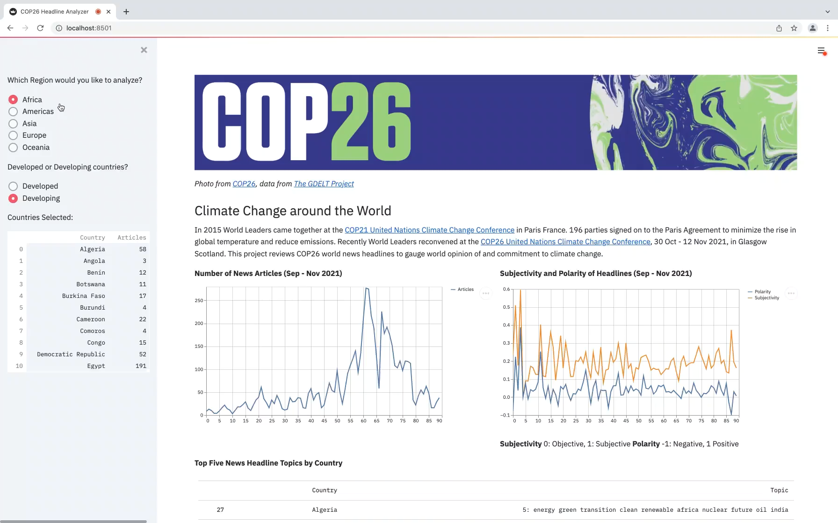
COP26 Headline Analyzer

Slide 7
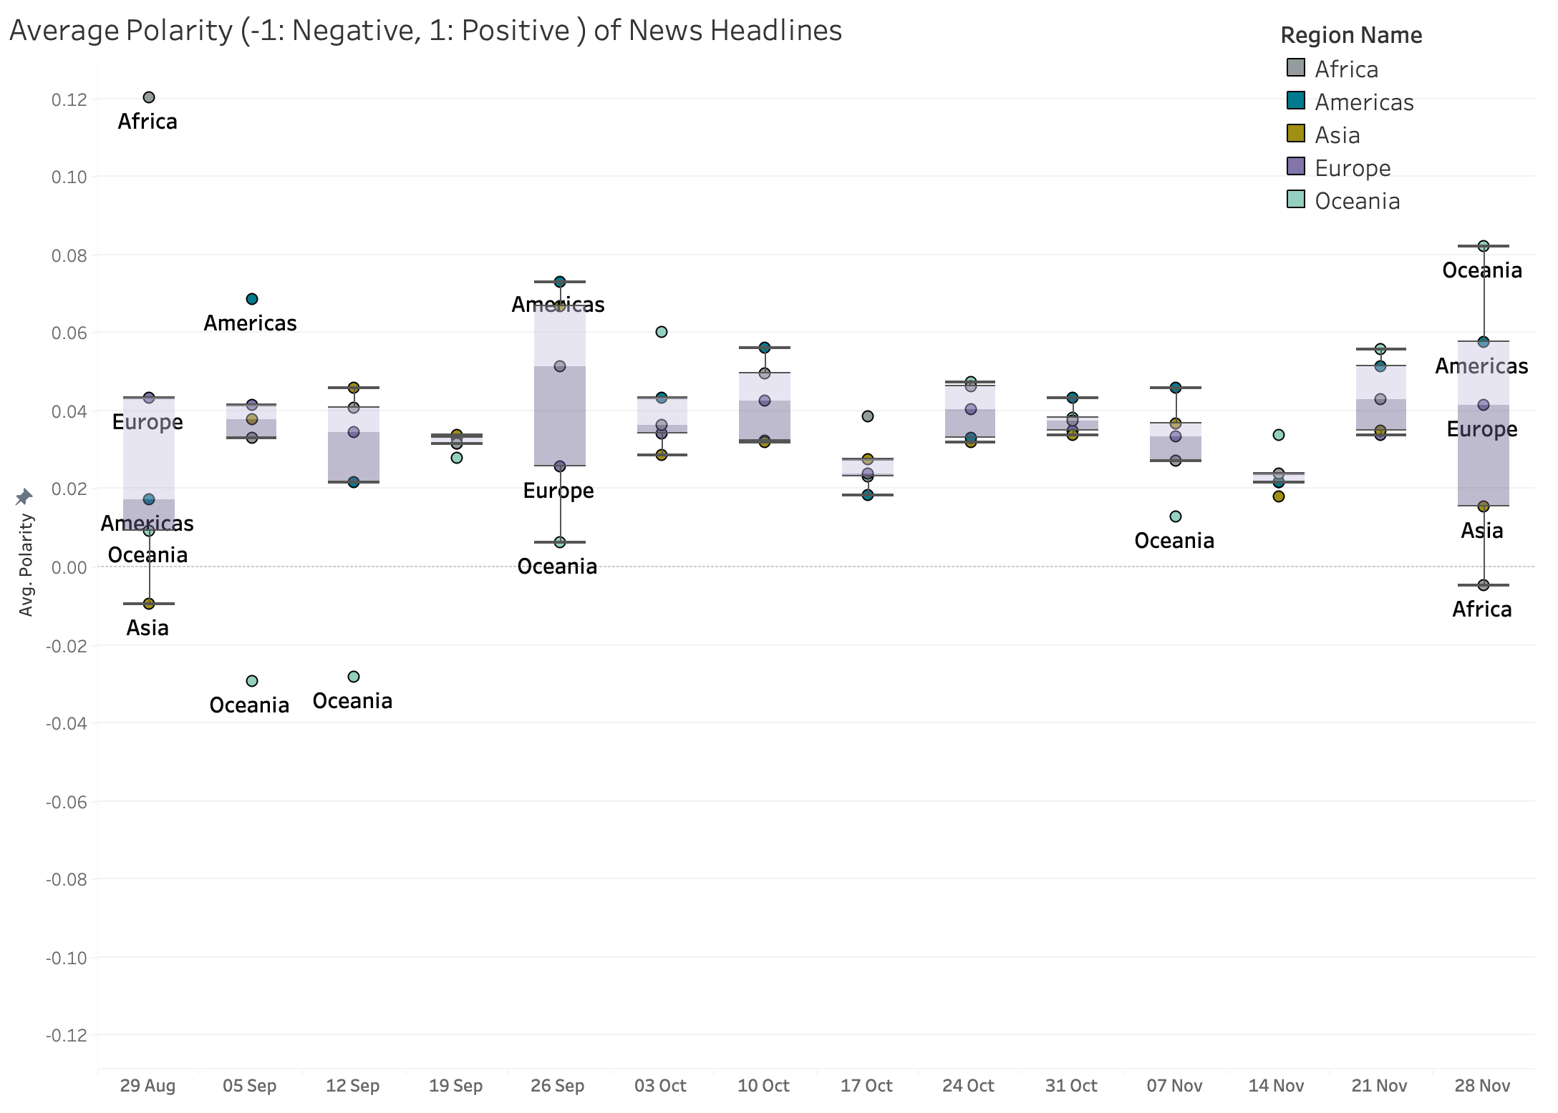
Headlines Slightly Positive
Relatively consistent, slightly positive view on COP26
Oceania began negative and trended positive
Africa began positive and trended neutral
Europe, Americas, and Asia were more consistently neutral
Waking up to climate change
Too little, too late
Good news locally

Slide 8
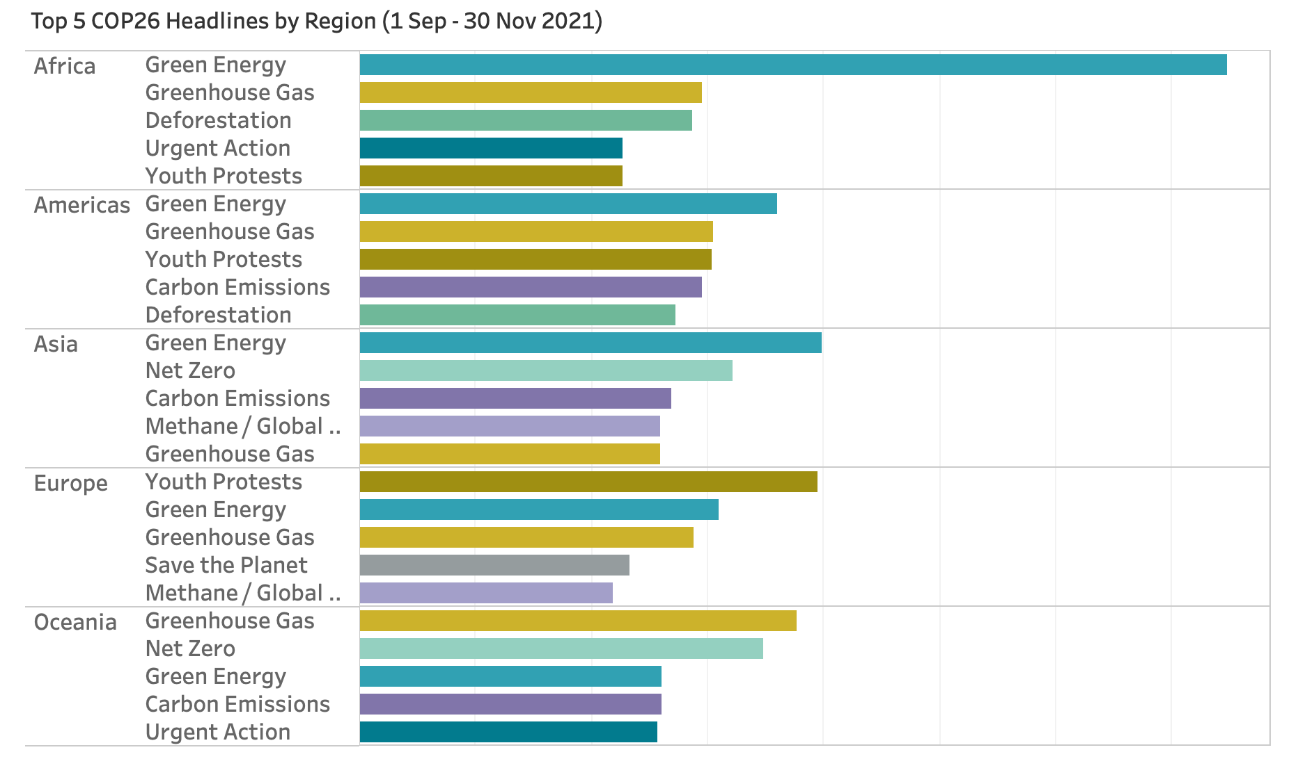
Regional Topics
Green Energy and Greenhouse Gas is global, especially Africa
Youth Protests are key in Europe and Americas
Net Zero is important in Asia and Oceania

Slide 9
Next Steps
Collect final, post-conference news articles
Improve translation
Develop COP26 Headline Analyzer tool
Consider clustering to identify deeper trends
Host COP26 Headline Analyzer and enable real time updates

Slide 10
Back up

Slide 11
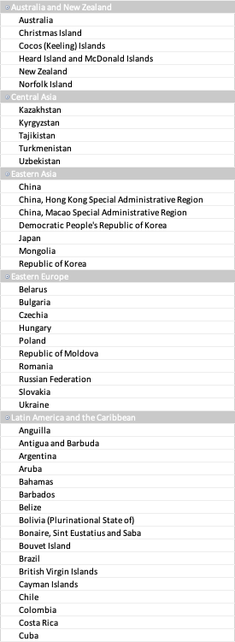
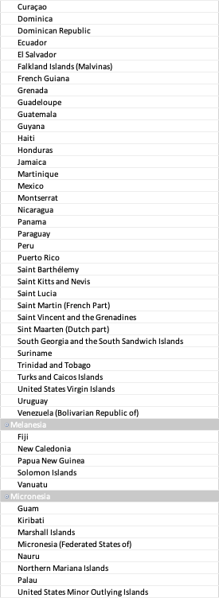
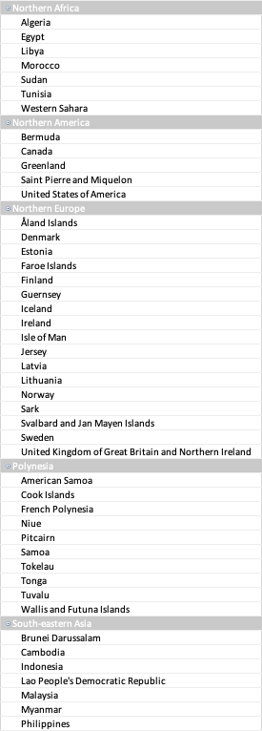
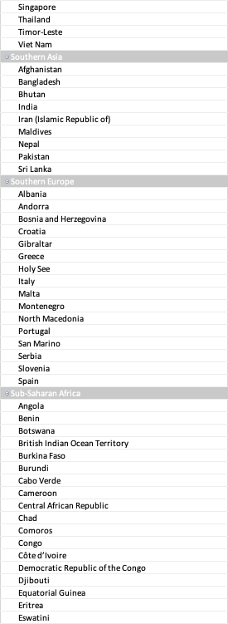
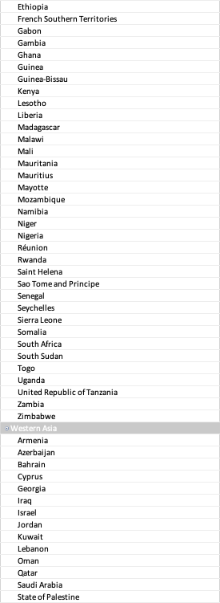
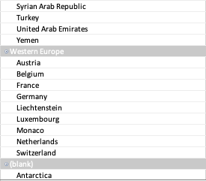
UN Countries / Sub-Regions
Data from UN Countries / Sub-regions

